Slide 1
Large Load: NV Energy’s Planning Process and Integrated Resource Plan
Shawn M. Elicegui & Jeff Brigger

Slide 2
Agenda
In-Flight Transmission Projects
Large Load Addition Process
NV Energy’s 2026 Integrated Resource Plan

Slide 3

In-Flight Transmission Projects

Slide 4
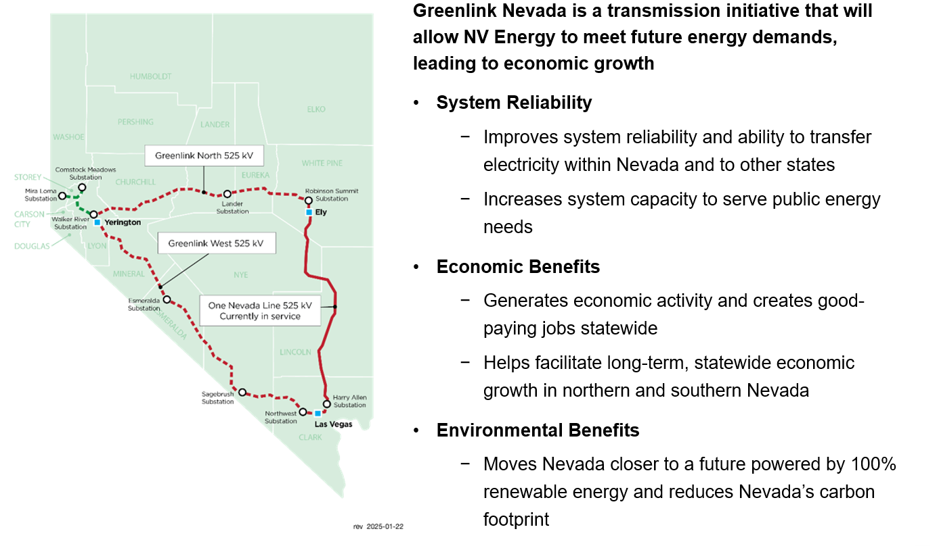
Greenlink Nevada

Slide 5
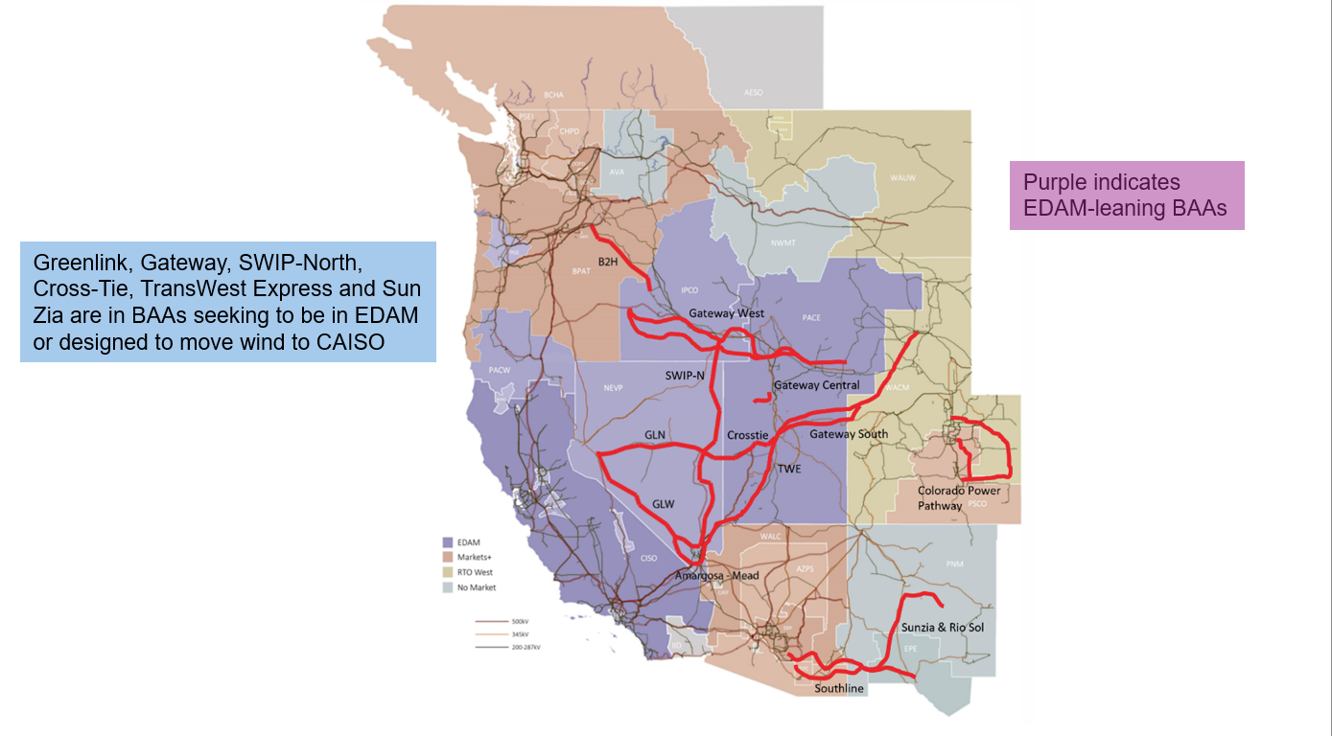
Western Transmission Lines

Slide 6
Large Load Addition Process

Slide 7
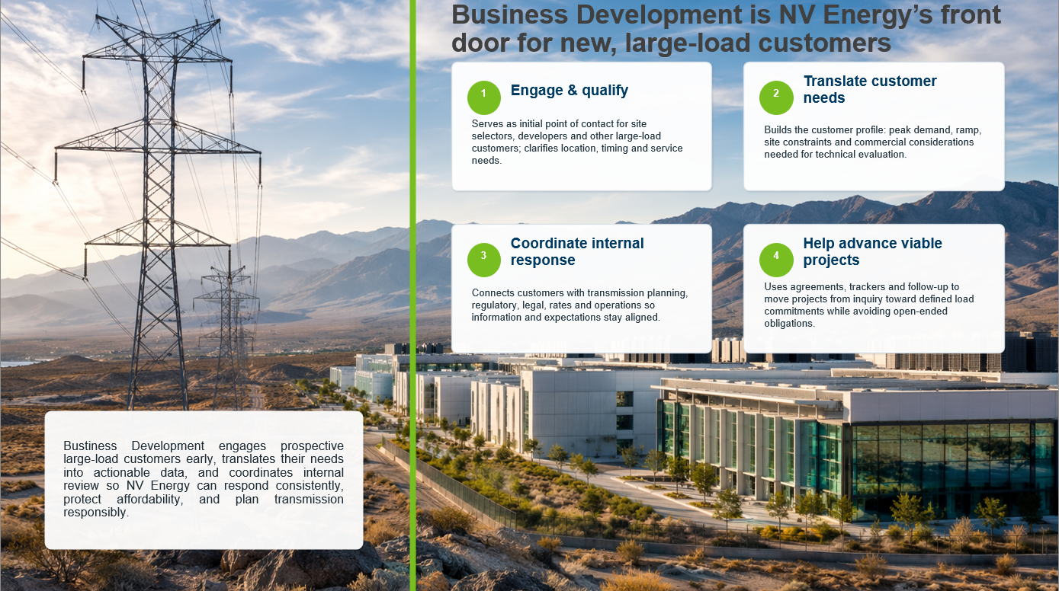
Business Development Team

Slide 8
What the Business Development Team Offers
Tailored support to help companies evaluate opportunities and make informed location decisions from initial planning to project implementation
  Economic development expertise and strong state and local agency relationships
The business development team partners with businesses, site selectors, developers, real estate professionals, city and county staff, and economic development organizations to support business growth and expansion. The team is a strategic resource throughout the site selection and development process, assisting with:
  Utility rate and tariff analysis
  Site selection support, coordinated site visits, and power availability
  Information on incentives, transportation infrastructure, workforce availability, and other key business considerations
  Due diligence power availability planning and support for industrial developers
  City and county planning and coordination for industrial development
  Transportation Electrification Programs – electric vehicle fleet planning and incentives
  Business Energy Services – energy efficiency incentive programs

Slide 9
Support, Tools and Resources
Discovery Packages
Provide customers with an assessment of infrastructure options required to serve their project and/or for distribution or transmission level service
  An engineering study may be needed to evaluate transmission and distribution service options; the business development team will guide, coordinate, and support customers through the process
Rate Estimates – Information needed to complete an estimate:
Ok: Size and end use for new facility
Better: Annual usage or facility peak demand or load factor
Best: Several months of historical bills. Minimum, a summer bill and winter bill
Nevada Site Locator:
Nevada Site Locator (NSL) is a GIS-based real estate database with demographic data, helping customers, site consultants, and real estate firms find the perfect location for their business.
Website Information & Data:
Western states business tax comparison
Cost of living index
Logistics data

Slide 10
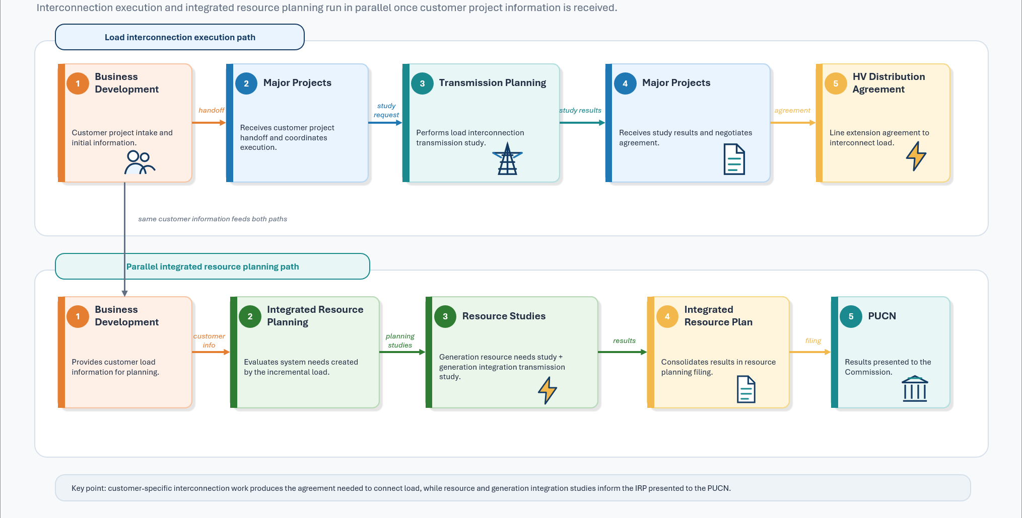
Major Projects – Load Interconnection and Integrated Resource Plan

Slide 11
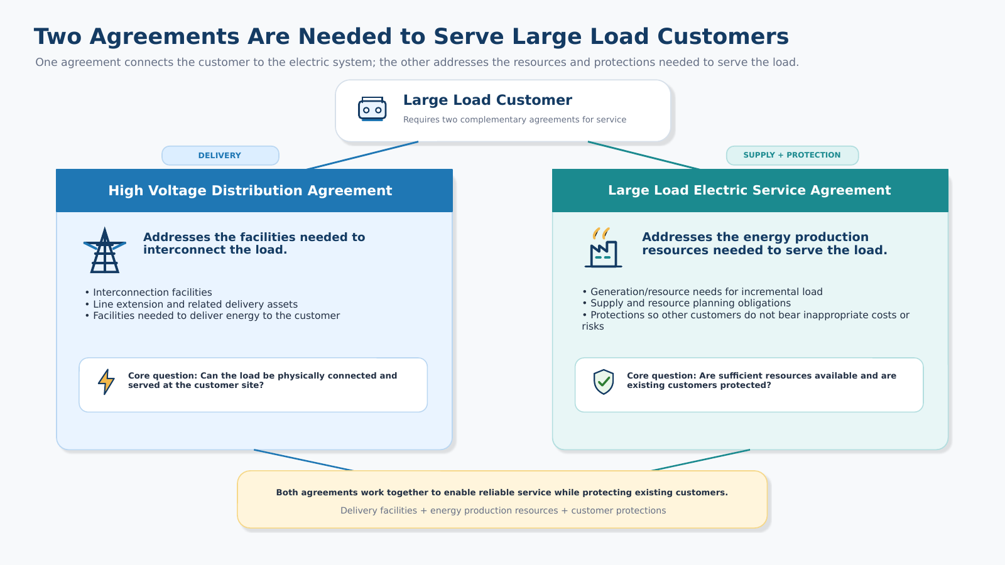
Requirements to Serve

Slide 12
NV Energy’s 2026 Integrated
Resource Plan

Slide 13
NV Energy’s 2026 Integrated
Resource Plan
All supply side additions are driven primarily by large load additions in the base case load forecast
Large load additions also change the characteristics of NV Energy’s load curve, driving higher system capacity factors, as well as significant changes in Sierra Pacific’s load curve
The preferred plan adds significant amounts of renewable energy by 2032 – over 4.3 GW (nameplate) of solar PV, over 5.1 GW storage and 180 MW of geothermal capacity (nameplate)
Changes in load characteristics and acceleration of large load service ramps influenced planning decisions and the selection of the preferred plan
  Supply chain constraints related to combustion turbines favor the use of aeroderivative units
  Designed to minimize near-term capital investment, near-term production cost and preserve flexibility to address changing load

Slide 14
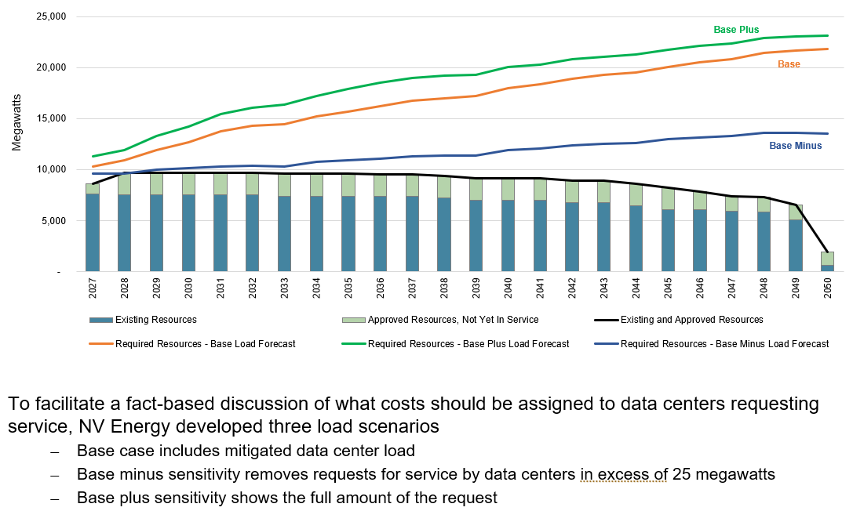
Projected Load Growth and Resource Needs

Slide 15
NV Energy’s 2026 Integrated
Resource Plan
A plan that meets large-customer demand while balancing speed to power, reliability and affordability
23
Power purchase
agreements
4.5 GW
New renewable
generation
5.4 GW
New energy
storage
1,200+ MW
New thermal
capacity
How the plan balances the three priorities
Speed to power: new resources and contracts are timed to serve large loads as they arrive
Reliability: storage and renewables are paired with new thermal units to protect reliability
Affordability: a framework intended to ensure that growth pays for itself and mitigates rate increases associated with in-flight capital projects

Slide 16
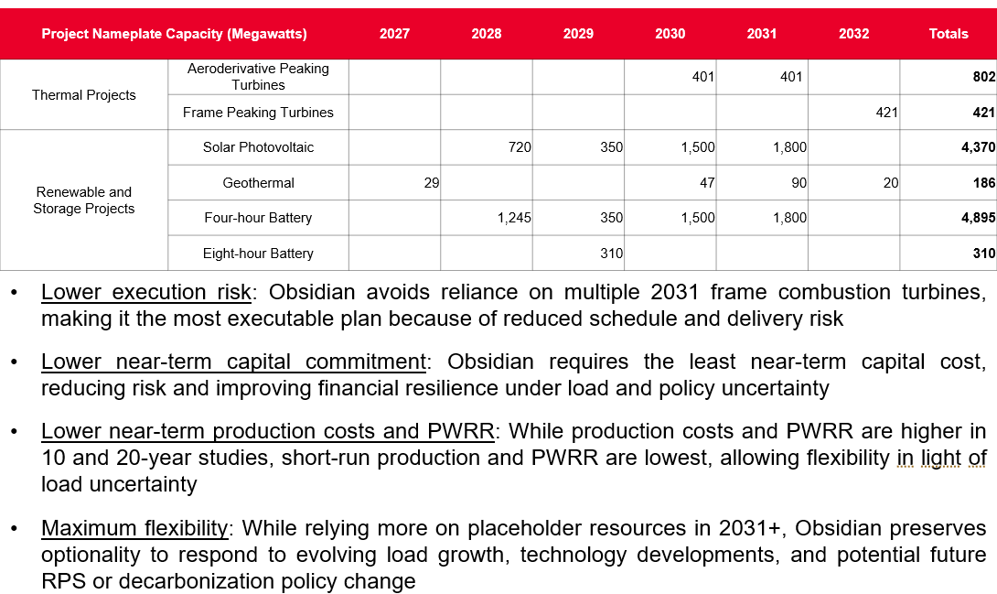
NV Energy’s 2026 Integrated
Resource Plan

